Slide 1
HEALING THROUGH ART
BY JASON, CORINNE And VALORIE

Slide 2
We also have: Aiqiao, Bessy, Richardo, Cinny, Bobby, Patricia

Slide 3
AGENDA
Welcome Healing Space & Kickoff
Healing Space Program Organizational Structure
Timeline & Milestones
4. The Program Overview & Action
--Stage 1 | Inner Restoration through Chinese Ink + Chinese snack (Month 3)
-- Stage 2 | Emotional Release through Oil Painting + Tea Cultural (Month 3)
-- Stage 3 | Creative Collaboration & Outdoor Sketching (Month 3)
5. Healing Through Art –Action Plan
6. Progress Evaluation Survey
7. Vision for Expansion

Slide 4
AGENDA
Welcome Healing Space Program & Kickoff
Healing Space Program Organizational Structure
The Program Timeline & Milestones
4. The Program Overview & Action
--Stage 1 | Inner Restoration through Chinese Ink+ Chinese snack (Month 3)
-- Stage 2 | Emotional Release through Oil Painting + Tea Cultural (Month 3)
-- Stage 3 | Creative Collaboration & Outdoor Sketching (Month 3)
5. The Program Progress Evaluation Survey
6. Vision for Expansion

Slide 5
1. WELCOME
PROJECT KICKOFF MEETING
Project Kickoff Class
Date: [March 6, 2025]
Organization/Team:
[Healing Space--Start Arts]
Presented by:
[Jason’s Team Total 12 members]

Slide 6
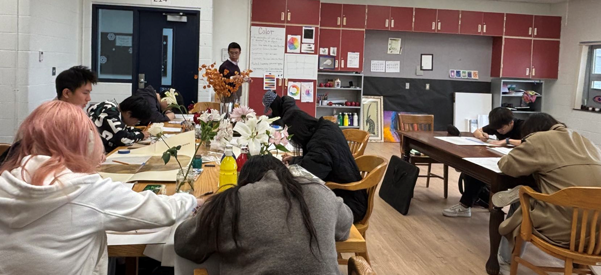
ART ALLOWS ME TO EXPRESS MYSELF AND UNLEASH MY TRUE POTENTIAL

Slide 7
AGENDA
Welcome Healing Space Program & Kickoff
Healing Space Program Organizational Structure
The Program Timeline & Milestones
--Stage 1 | Inner Restoration through Chinese Ink + Chinese snack (Month 3)
-- Stage 2 | Emotional Release through Oil Painting + Tea Cultural (Month 3)
-- Stage 3 | Creative Collaboration & Outdoor Sketching (Month 3)
4. The Program Overview & Action
5. The Program Progress Evaluation Survey
6. Vision for Expansion

Slide 8
2. 1 TEAM MEMBERS
AND ROLES & RESPONSIBILITIES
Operating the Healing Through Art Program as a Corporate Initiative

Slide 9
2.2 HEALING SPACE PROGRAM ORGANIZATIONAL STRUCTURE
Art Healing Project Management Team
│
──────────────────────────────────────────────────
│ │ │ │ Project Founder Professional Consultants Students Ambassador Marketing & Outreach
(Jason, Corinne) (Zhonghuan Li) (XXXX) (XXXX) ───────────────────────────────────────────────────
Operations & Logistics Team
───────────────────────────────────────────────────
│ │ │
Art Instructor Music Instructor Project Management
(Ziyu Liu) (XXXX) (Valorie)
…….

Slide 10
HEALING SPACE PROGRAM VISION FOR EXPANSION
In colors and light, healing quietly unfolds.
Here, we create a sanctuary where art mends the soul.
Every brushstroke is a gentle touch;
every act of creation, a step toward renewal.
Whether you seek a space to heal
or a way to bring hope to others,
we invite you to join us.
Together, let art become a source of comfort and connection—
bringing warmth and peace to the world,
one heart at a time.
Join Us｜Heal with Art. Inspire with Heart.
OUR VISON
Using art as a medium, we aim to promote the widespread practice of emotional healing and establish a national and global Healing Through Art platform, empowering more individuals to find emotional recovery and personal growth through creativity.

Slide 11
AGENDA
Welcome Healing Space Program & Kickoff
Healing Space Program Organizational Structure
The Program Timeline & Milestones
4. The Program Overview & Action
--Stage 1 | Inner Restoration through Chinese Ink + Chinese snack (Month 3)
-- Stage 2 | Emotional Release through Oil Painting + Tea Cultural (Month 3)
-- Stage 3 | Creative Collaboration & Outdoor Sketching (Month 3)
5. The Program Progress Evaluation Survey
6. Vision for Expansion

Slide 12

3. TIMELINE & MILESTONES
Stage 1 | Inner Restoration through Chinese Ink (Month 3)
Stage 2 | Emotional Release through Oil Painting (Month 3)
Stage 3 | Creative Collaboration & Outdoor Sketching (Month 3)
Art Mediums · Healing Growth Pathway
Ink for Inner Cultivation → Oil for Emotional Expression → Sketching for Connection & Creativity
Focus → Expression → Collaboration
A therapeutic journey from Self-Restoration to Emotional Release to Creative Empowerment

Slide 13
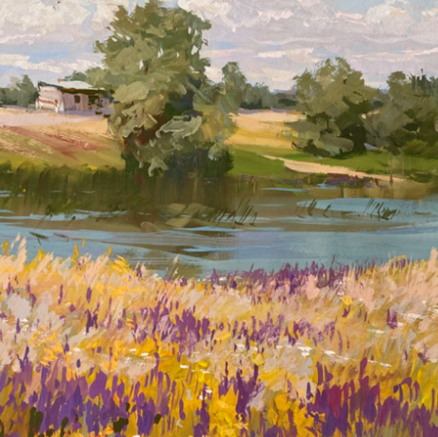
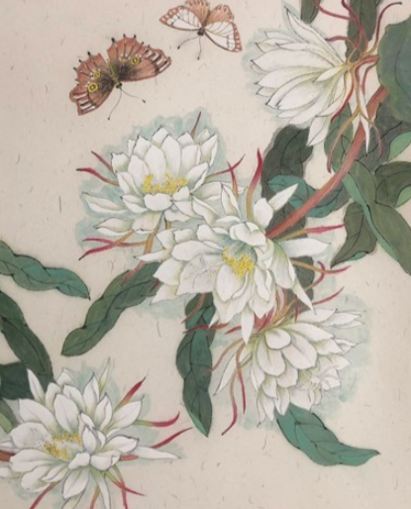
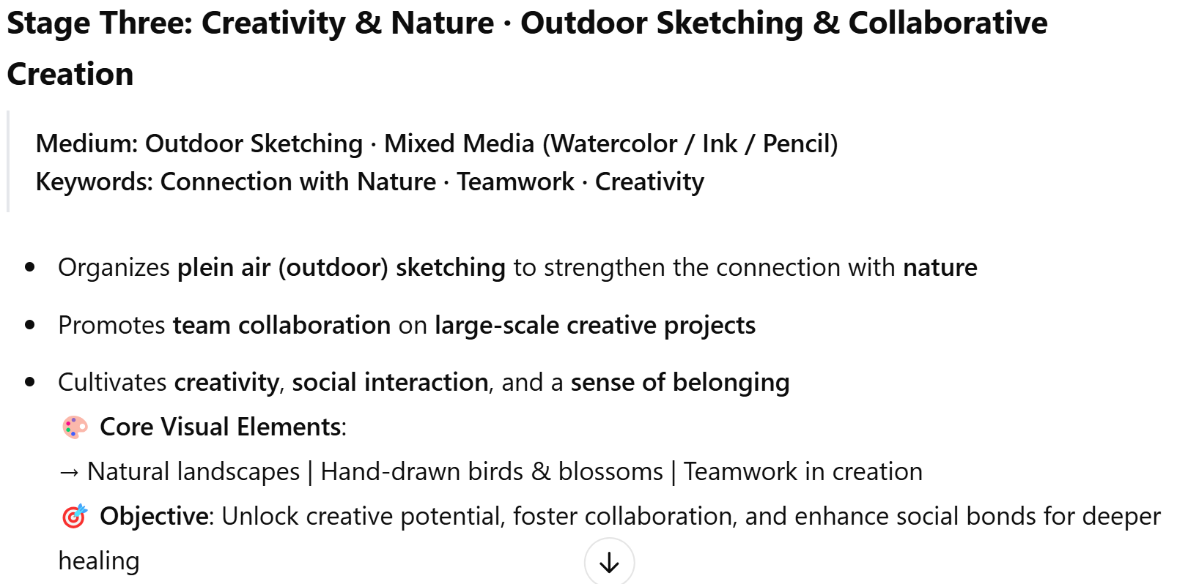
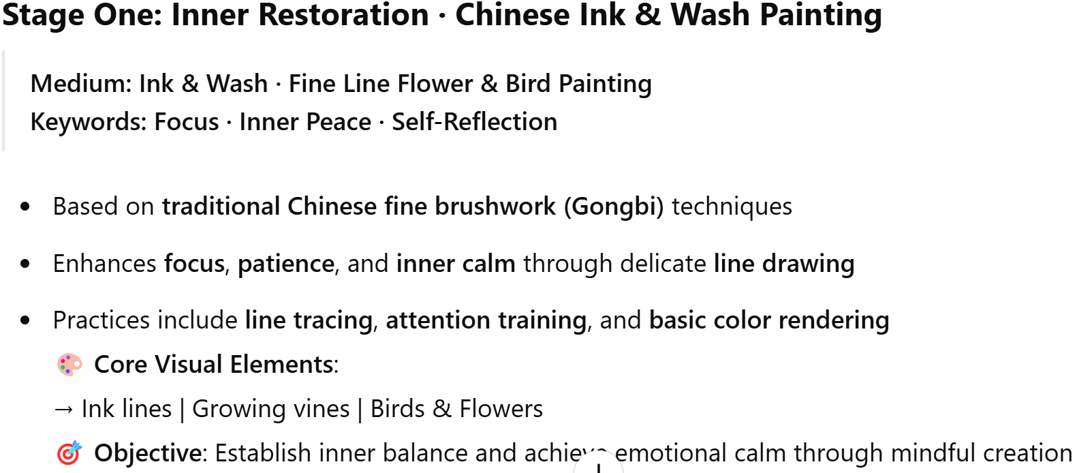
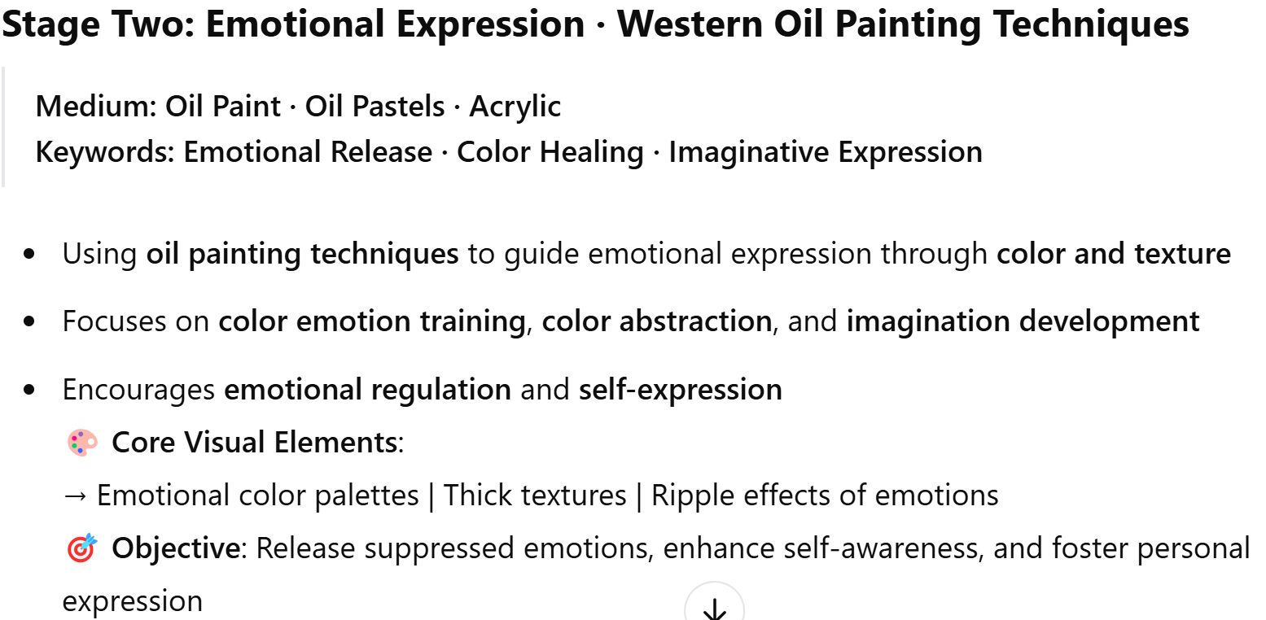
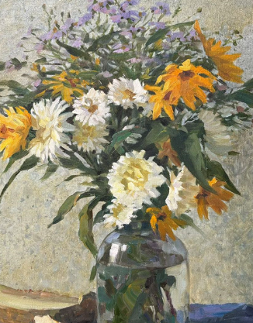
HEALING THROUGH ART · THREE-STAGE PROGRAM OVERVIEW
—— INK
—— OIL
——SKETCHING
A JOURNEY OF INNER HEALING
Sketching
Ink
Oil
Notes:
Stage One: Inner Restoration · Chinese Ink & Wash Painting
Medium: Ink & Wash · Fine Line Flower & Bird Painting
Keywords: Focus · Inner Peace · Self-Reflection
Based on traditional Chinese fine brushwork (Gongbi) techniques
Enhances focus, patience, and inner calm through delicate line drawing
Practices include line tracing, attention training, and basic color rendering
🎨 Core Visual Elements:
→ Ink lines | Growing vines | Birds & Flowers
🎯 Objective: Establish inner balance and achieve emotional calm through mindful creation
Stage Two: Emotional Expression · Western Oil Painting Techniques
Medium: Oil Paint · Oil Pastels · Acrylic
Keywords: Emotional Release · Color Healing · Imaginative Expression
Using oil painting techniques to guide emotional expression through color and texture
Focuses on color emotion training, color abstraction, and imagination development
Encourages emotional regulation and self-expression
🎨 Core Visual Elements:
→ Emotional color palettes | Thick textures | Ripple effects of emotions
🎯 Objective: Release suppressed emotions, enhance self-awareness, and foster personal expression
Stage Three: Creativity & Nature · Outdoor Sketching & Collaborative Creation
Medium: Outdoor Sketching · Mixed Media (Watercolor / Ink / Pencil)
Keywords: Connection with Nature · Teamwork · Creativity
Organizes plein air (outdoor) sketching to strengthen the connection with nature
Promotes team collaboration on large-scale creative projects
Cultivates creativity, social interaction, and a sense of belonging
🎨 Core Visual Elements:
→ Natural landscapes | Hand-drawn birds & blossoms | Teamwork in creation
🎯 Objective: Unlock creative potential, foster collaboration, and enhance social bonds for deeper healing

Slide 14
STAGE 1 | INNER RESTORATION THROUGH CHINESE INK (MONTH 3)
FROM THE BEGINNING OF MARCH TO THE END OF MAY
3.1
Objective: Focus · Calmness · Mindfulness
Milestones:
Week 1 -2→ Basic Line Drawing (Flowers & Birds)
Week 3-5 → Attention Patience Training ， Sketching from
life(Fine Brush Control)
Week 6-9 → Ink Color Blending ， Sketching from life(Gongbi
Techniques)
Week 10-12 → Milestone ① → Complete First Full Ink Painting
Outcome: Mastery of line, calm focus, inner balance.

Slide 15
STAGE 2 | EMOTIONAL RELEASE THROUGH OIL PAINTING (MONTH 3)
(TO BE DETERMINED)
3.2
Stage 2 | Emotional Release through Oil Painting (Month 2)
Objective: Emotional Expression · Color Therapy
Milestones:
Week 1-2 → Color Emotion Training (Palette Exploration)
Week 3-5→ Imaginative Color Exercises (Abstract Composition)
Week 6-10 → Oil Painting Texture Techniques (Layering & Impasto)
Week 11-12 → Milestone ② → Complete Emotional Expression Artwork
Outcome: Emotional awareness, creative freedom, personal storytelling.

Slide 16
STAGE 3 | CREATIVE COLLABORATION
& OUTDOOR SKETCHING (MONTH 3)
(TO BE DETERMINED)
3.3
Objective: Nature Connection · Creativity · Teamwork
Milestones:
Week 1-4 → Outdoor Sketching Practice (Nature Observation)
Week 5-7 → Group Composition Planning (Collaborative Design)
Week 8-10 → Large-Scale Team Art Project (Watercolor / Mixed Media)
Week 11-12 → Milestone ③ → Final Artwork Showcase Outdoor Exhibition
Outcome: Connection with nature, teamwork, creative expression in community.

Slide 17
AGENDA
Welcome Healing Space & Kickoff
Healing Space Program Organizational Structure
Timeline & Milestones
4. Healing Space Program Overview & Action
--4.1 Stage 1 | Inner Restoration through Chinese Ink + Chinese snack (Month 3)
-- 4.2 Stage 2 | Emotional Release through Oil Painting + Tea Cultural (Month 3)
-- 4.3 Stage 3 | Creative Collaboration & Outdoor Sketching (Month 3)
5. The Program Progress Evaluation Survey
6. Vision for Expansion

Slide 18
4. HEALING SPACE PROGRAM OVERVIEW & ACTION
4.1 STAGE ONE
INNER RESTORATION THROUGH CHINESE INK (MONTH 3)
FROM THE BEGINNING OF MARCH TO THE END OF MAY

Slide 19
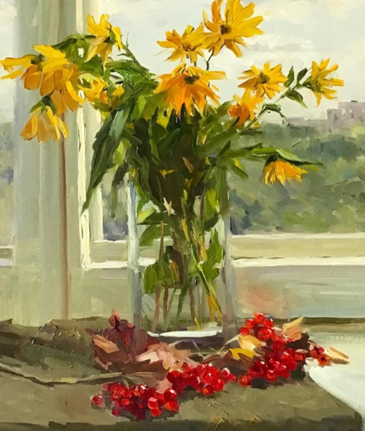
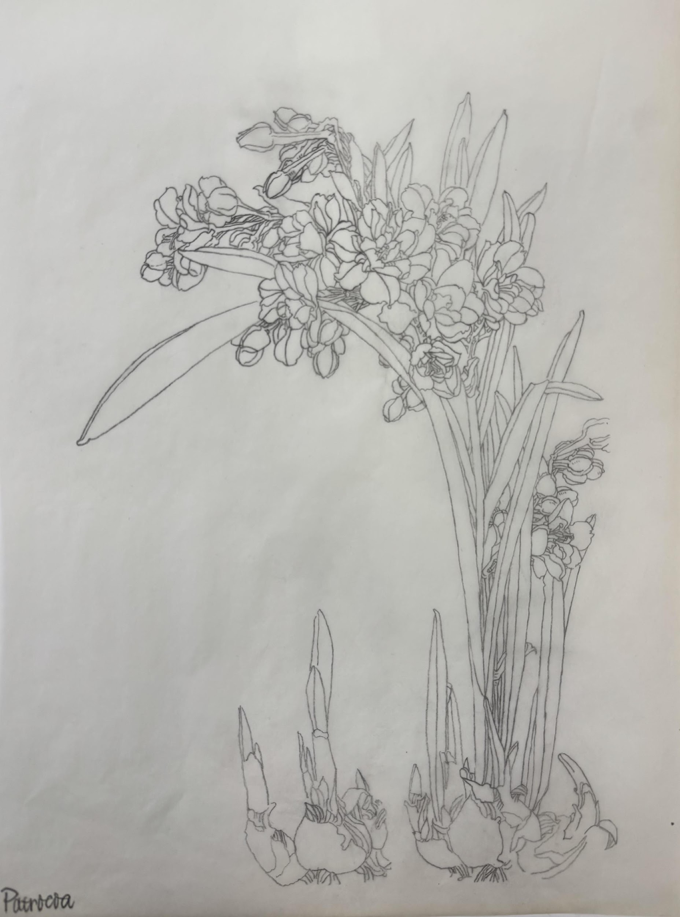

PROGRAM OVERVIEW &
QUESTIONNAIRE SURVEY
Healing Salon | A Journey of Light and Connection ✨
This is a space where you are invited to slow down and listen to the quiet whispers of your heart.
With a single mindful breath, a painting born from instinct, or a warm cup of tea shared in stillness,
each healing moment becomes a doorway—guiding you back to yourself, and forward toward the light.
At the Healing Space, there is no need for masks or expectations.
Here, we heal in warmth, and in sharing, we bring light and strength to one another.
Our Action and Planing

Slide 20
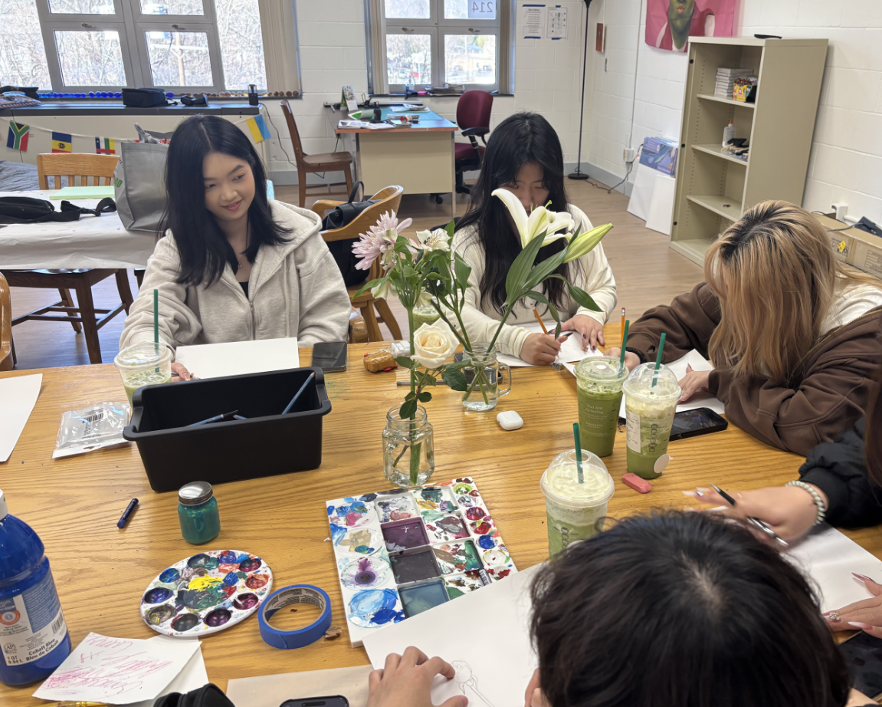
QUESTIONNAIRE SURVEY—STAGE ONE
Take a Moment to Listen to Yourself – A Gentle Invitation to Self-Care ✨
In the midst of busy days and endless responsibilities, we often forget to pause
and quietly ask ourselves, “How am I really feeling lately?”
Perhaps you are working hard toward your dreams,
or carrying the weight of expectations from life and those around you.
But your heart also deserves a moment to breathe, to rest, and to be heard.
We invite you to take a few minutes to complete a gentle, reflective questionnaire.
It’s not an assessment, and there are no right or wrong answers.
It’s simply a quiet conversation with yourself—
a way to understand where you are right now,
and to offer yourself a little extra kindness and care.
And once you finish,
we welcome you to join our Art Healing Space,
where you can express yourself freely,
not with words, but with color, shape, and creativity.
You don’t need any artistic experience—just an open heart and a willingness to explore.
Here, you can relax, create, and reconnect with the peace that’s already within you.
You are always welcome here.
Let’s take this gentle journey together—
from the heart, towards the light.
Listening to Your Voice—Question Survey-Early Stage
This survey is anonymous and confidential. Your honest feedback is greatly appreciated

Slide 21
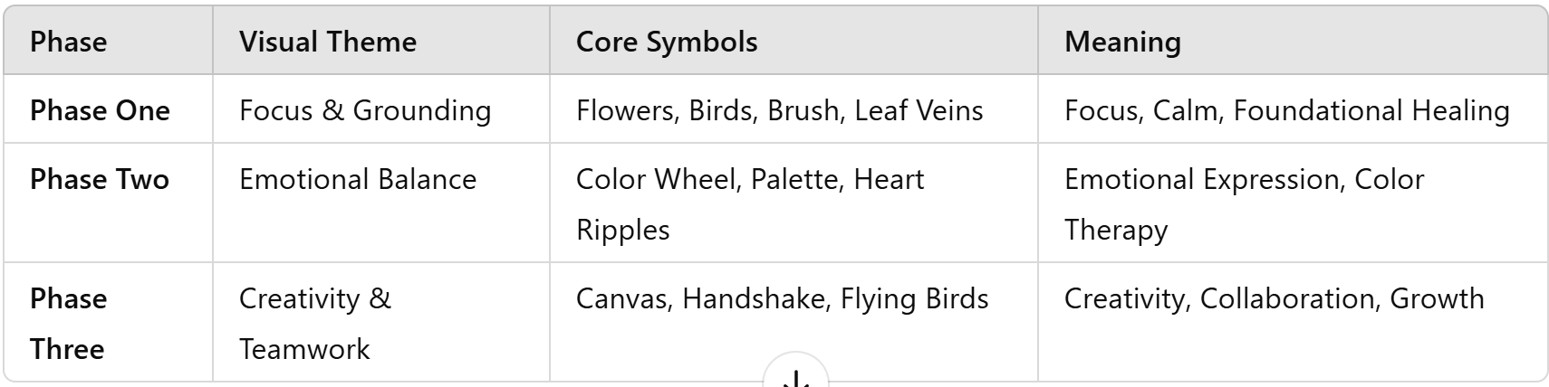
4. HEALING THROUGH ART ACTION
—STAGE ONE
🔶 Design Principles
1). Icons represent each phase and course dimension, making the learning journey visual and intuitive.
2). The style reflects healing, connection, and growth, aligned with the project's therapeutic purpose.
3).Unified design language: warm, minimalist, symbolic.
4).Easy application across digital and physical platforms.
🔶 Action Plan

Slide 22
4.1 HEALING THROUGH ART ACTION
—STAGE ONE
Phase One
Foundation & Focus Training
🎨 Keywords: Focus, Calmness, Basic Skills, Patience
1) .Focus Training
Icon: A brush sketching a budding flower
Meaning: Mindful strokes foster inner peace and focus
Course Breakdown Icons:
  Line Drawing 1: Brush + Single Leaf
  Line Drawing 2: Hands holding a sapling
  Line Drawing 3: Bird feather detail + Focused eye

Slide 23
4.2 HEALING THROUGH ART ACTION
—STAGE ONE
Phase One
Foundation & Focus Training
🎨 Patience & Endurance Training
2). Icon: A climbing vine wrapping around an easel
Meaning: Growth through steady effort
Course Breakdown Icons:
  Initial Coloring: Palette with gradient shades
  Layered Rendering: A leaf with ripple lines showing layers
  Background Development: Expanding halo behind the artwork
  Detail Highlighting: Close-up of a bird's eye and flower stamens

Slide 24
4.3 HEALING THROUGH ART ACTION
—STAGE ONE
Phase Two
Emotional Regulation & Expression
🎨 Keywords: Color, Emotional Release, Self-Expression
1) .Color Emotion Training
Icon: A color palette with a beating heart in the center
Meaning: Emotions revealed through colors
Course Breakdown Icons:
  Brightness/Contrast: Yin-Yang black & white contrast
  Hue and Tone Balance: Spiral of color blending into a heart shape

Slide 25
4.4 HEALING THROUGH ART ACTION
—STAGE ONE
Phase Two
Emotional Regulation & Expression
2). Emotional Expression via Color
Icon: Gentle hands releasing a colorful butterfly
Meaning: Transformation through emotional release
Course Breakdown Icons:
  Cool vs. Warm Color Expression
  Emotional State Color Map (Gradient Heart)
3. Imagination Training
Icon: Abstract flowers and birds floating under a starry sky
Meaning: Unbound creativity and expanded thinking
Course Breakdown Icons:
  Color Space Mixing: Overlapping color blocks
  Color Abstraction: Collage-style composition

Slide 26
4.5 HEALING THROUGH ART ACTION
—STAGE ONE
Phase Three
Creativity & Collaboration
🎨 Keywords: Creation, Teamwork, Exhibition, Achievement
1). Team Collaboration Training
Icon: Four hands forming a complete canvas
Meaning: Collective strength creates holistic beauty
Course Breakdown Icons:
  Collaborative Composition: Hands shaking in unity
  Color Scheme Design: Multi-colored hands painting together
  Detail Rendering: Puzzle-like composition pieces
  Final Display: A quilt of artworks forming a flock of flying birds

Slide 27
4.6 HEALING THROUGH ART ACTION
—STAGE ONE
Phase Three
Creativity & Collaboration
2). Outdoor Sketching & Nature Connection
Icon: Distant mountains with a hand holding a blooming flower
Meaning: Healing connection with nature
Course Breakdown Icons:
  Indoor Sketching: Potted plant with line art
  Outdoor Sketching: Blossoms and landscapes together
  Creative Composition: Free-flying birds with blooming flowers

Slide 28
SECTION ONE 20250327 NO.4
From the beginning of March to the end of March

Slide 29
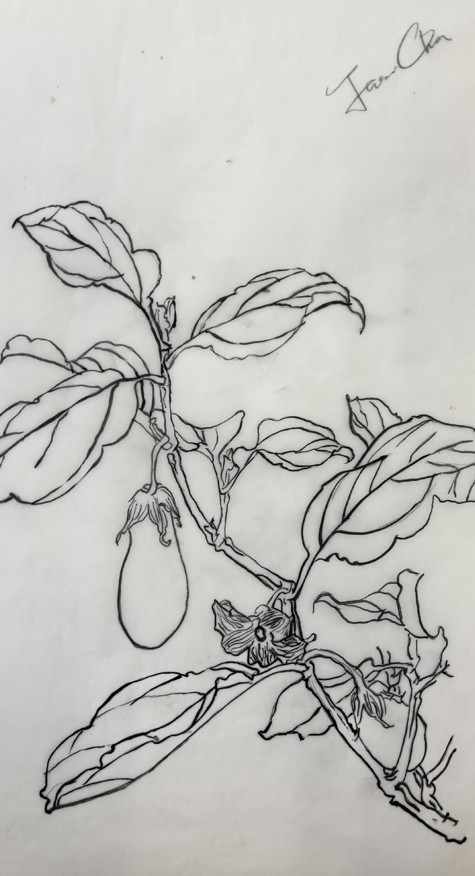
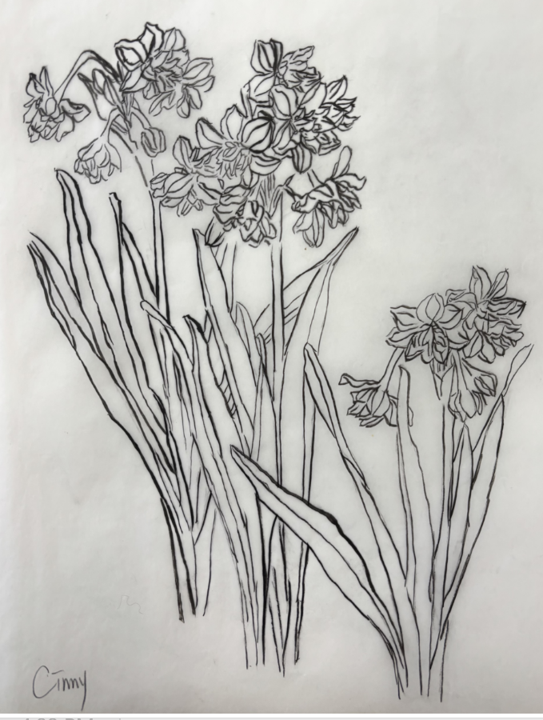
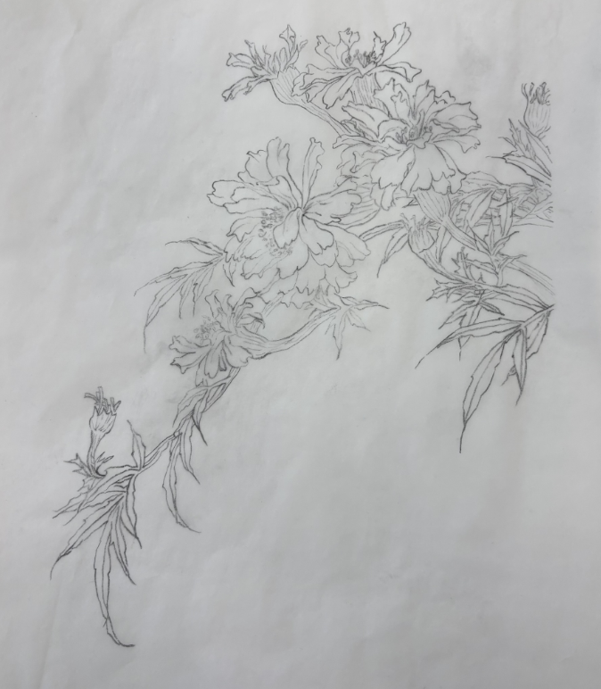
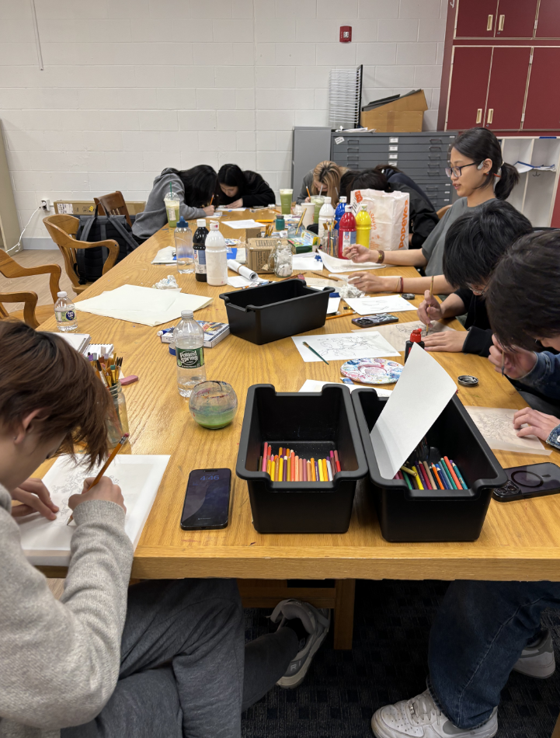
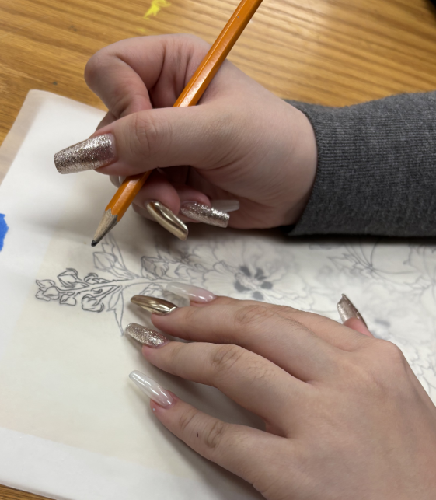
SECTION ONE 20250306 NO.1
Reproduce
Pictures in the Class –NO.1

Slide 30
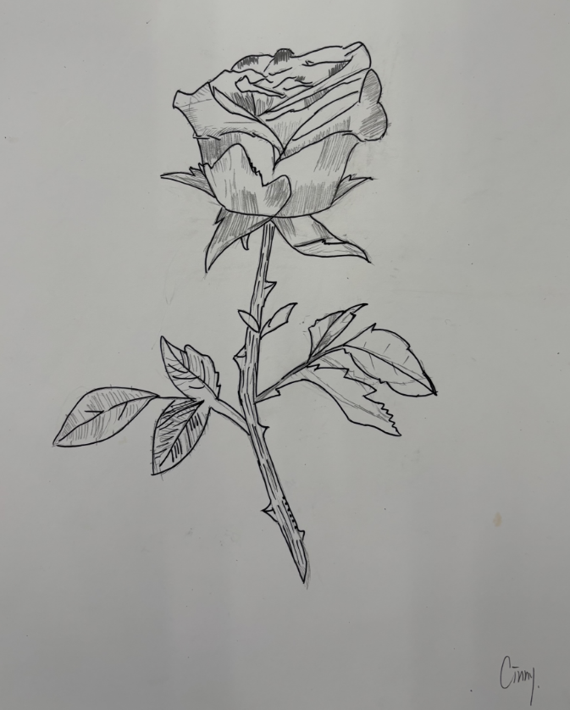
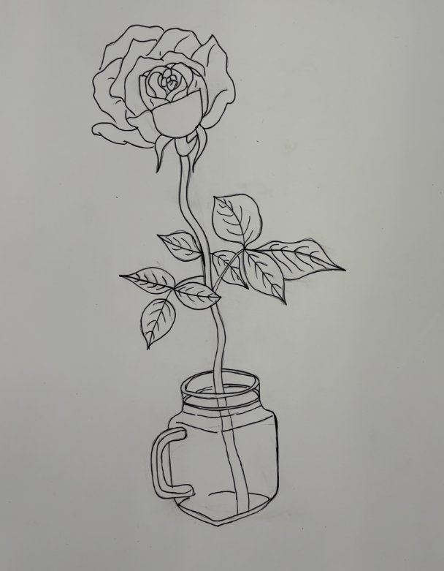
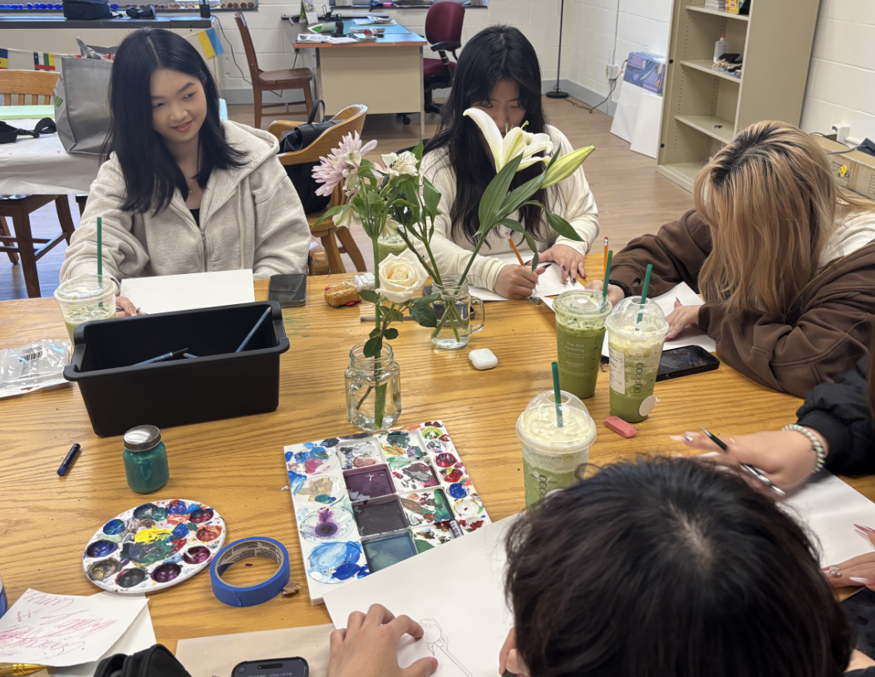
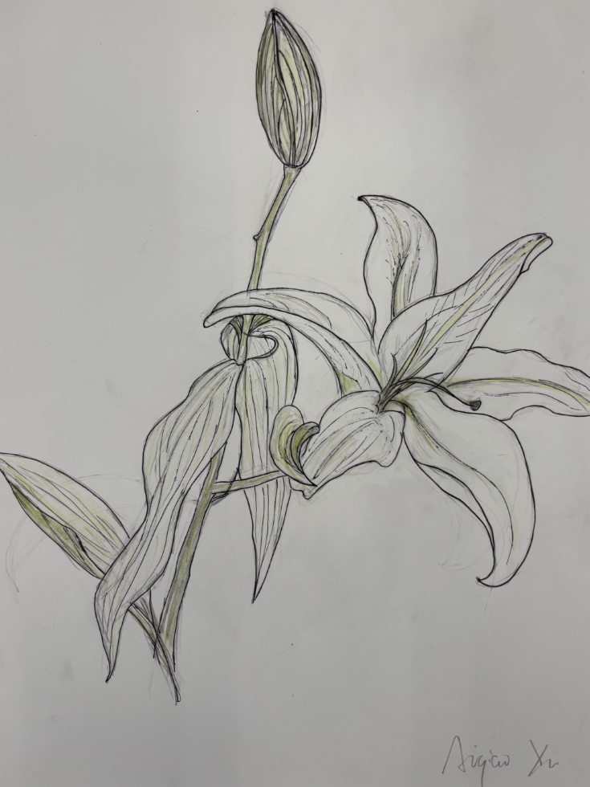
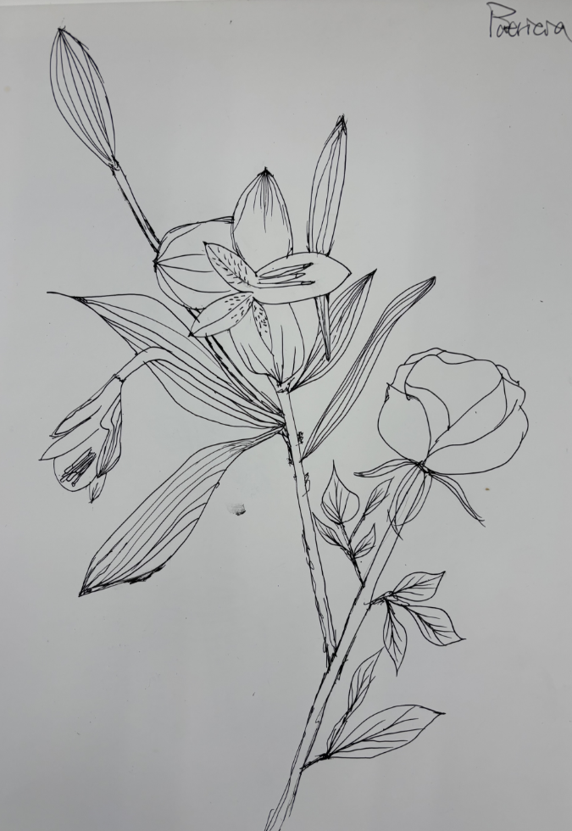
SECTION ONE 20250313 NO.2
Enjoy Sketching from life
Pictures in the Class-NO.2

Slide 31
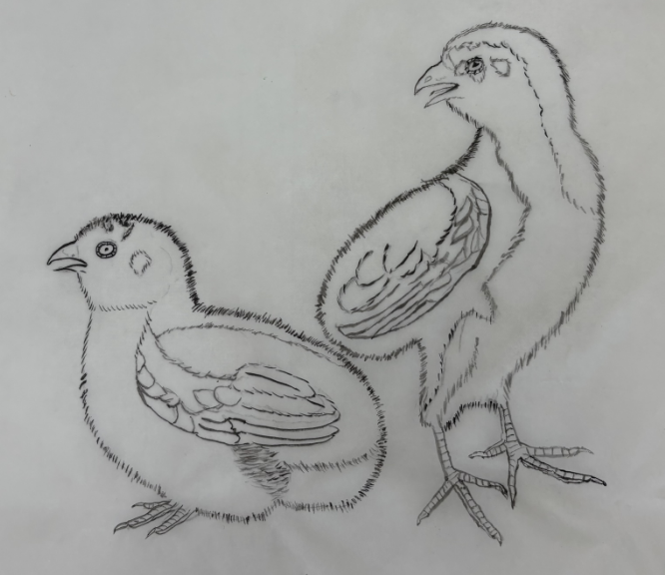
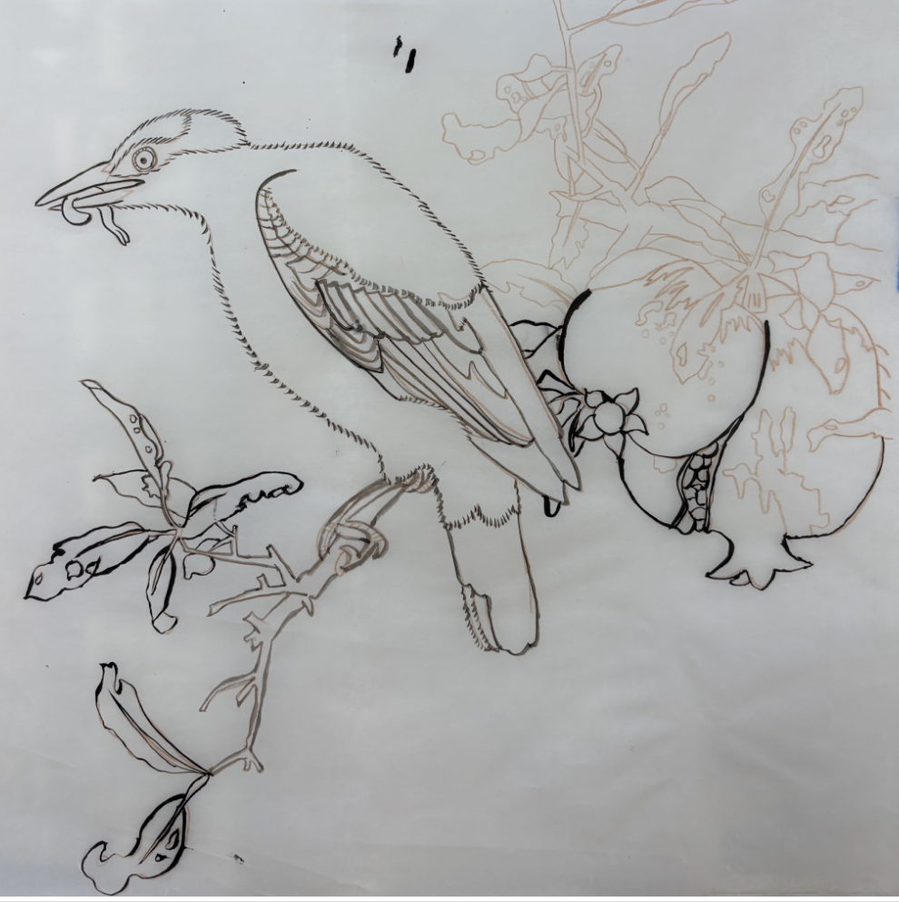
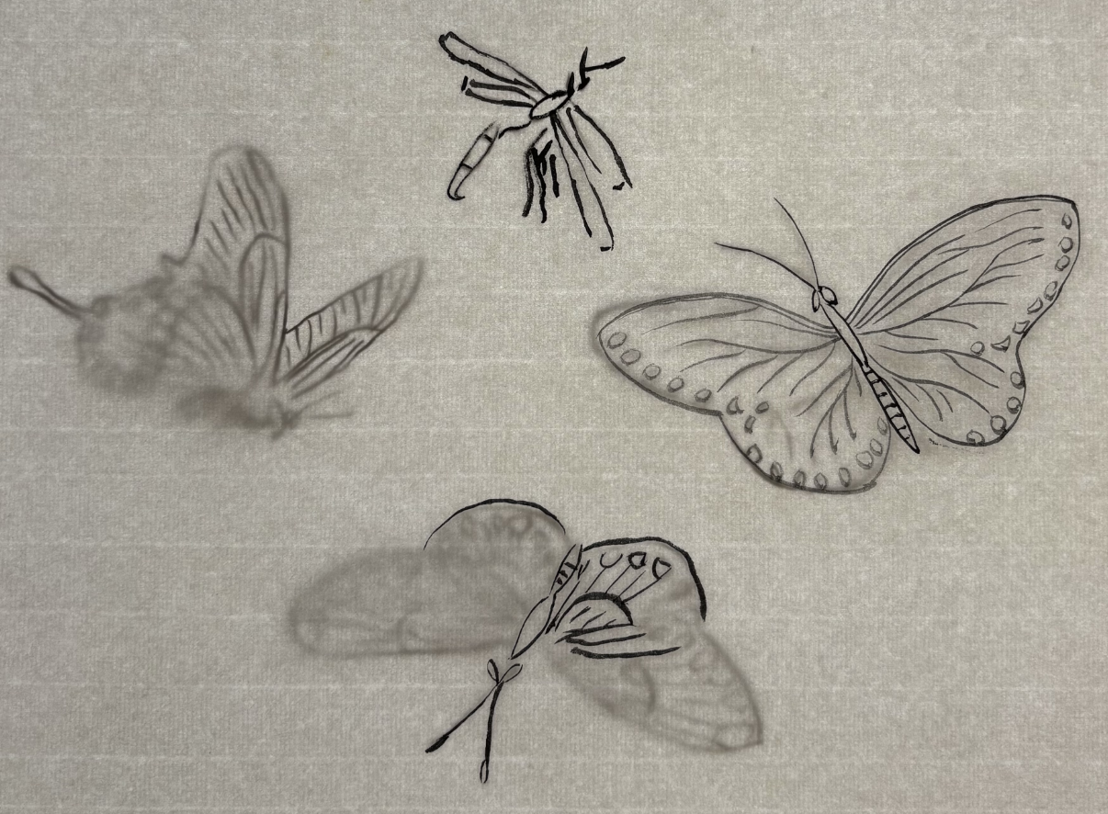
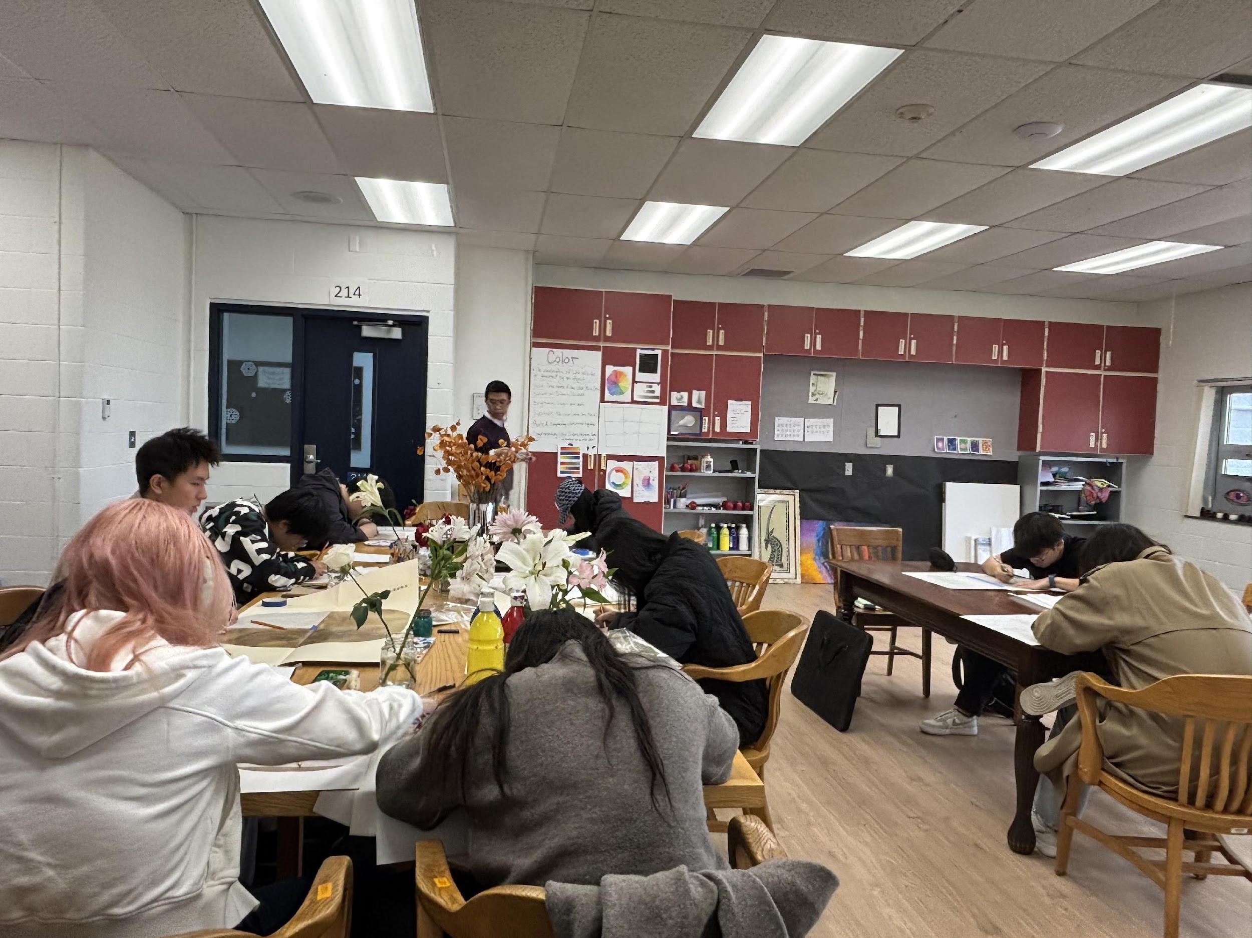
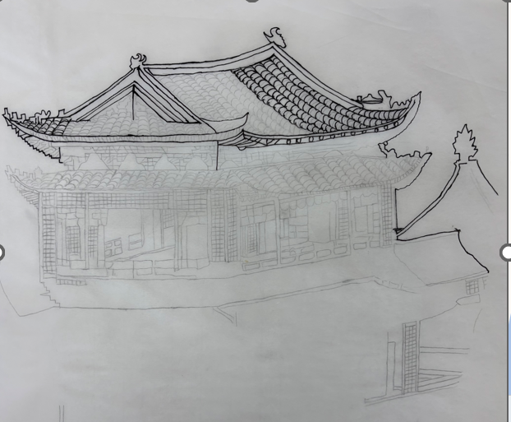
SECTION ONE 20250320 NO.3
Reproduce
Pictures in the Class –NO.3

Slide 32
SECTION ONE 202503XX NO.XX
……
From the beginning of March to the end of March

Slide 33
QUESTIONNAIRE SURVEY___
STAGE ONE
Test about middle of April
Listening to Your Voice—Question Survey- T Stage
This survey is anonymous and confidential. Your honest feedback is greatly appreciated

Slide 34
SECTION ONE 202504XX NO.XX
From the beginning of April to the end of April

Slide 35
QUESTIONNAIRE SURVEY___
STAGE ONE
Test about early of May
待翻译
Listening to Your Voice—Question Survey-Intermediate Stage
This survey is anonymous and confidential. Your honest feedback is greatly appreciated

Slide 36
SECTION ONE 202505XX NO.XX
……
From the beginning of March to the end of May

Slide 37
QUESTIONNAIRE SURVEY
____STAGE ONE
Test about end of May
Listening to Your Voice—Question Survey-Final Stage
This survey is anonymous and confidential. Your honest feedback is greatly appreciated

Slide 38
🌿 EXPECTED GOALS OF STAGE ONE
INNER RESTORATION · CHINESE INK & WASH PAINTING
🌱 Program Vision & Purpose
To create a peaceful and focused creative space, helping participants achieve emotional balance and inner calm through traditional Chinese painting practices.
To use art as a tool for mindfulness and self-regulation, strengthening concentration and patience while reducing anxiety and stress.
To foster a deep connection with nature, encouraging participants to observe and appreciate natural beauty through sketching and painting.
Expected Outcomes
✅ Focused Attention & Concentration
Participants will learn to control their breath and focus through fine line drawing techniques, enhancing attention span and mindfulness.
✅ Patience & Emotional Balance
The repetitive yet meditative practice of Gongbi (fine brush) painting will nurture patience and promote emotional stability.
✅ Improved Observation Skills
Through both indoor and outdoor sketching, participants will develop an acute awareness of natural forms, details, and harmony.
✅ Stress Reduction & Inner Peace
Immersive engagement in traditional art forms will relieve stress and foster a deep sense of calm and inner healing.
✅ Artistic Skill Development
Participants will gain proficiency in basic Chinese painting techniques, including line work, composition, and light color washes.
✅ Creative Confidence & Personal Growth
Completing personal artwork (both indoor and outdoor sketching and one complete Gongbi piece) will build self-confidence and encourage personal expression.

Slide 39
STAGE ONE END

Slide 40
4.2-4.3 Stage Two & Stage Three
Healing Space Program Overview & Action
Stage 2 | Emotional Release through Oil Painting + Tea Cultural (Month 3)
Stage 3 | Creative Collaboration & Outdoor Sketching (Month 3)
(To Be Determined)

Slide 41
AGENDA—STAGE TWO
Welcome Healing Space & Kickoff
Healing Space Program Organizational Structure
Timeline & Milestones
4. Healing Space Program Overview & Action
--4.1 Stage 1 | Inner Restoration through Chinese Ink + Chinese snack (Month 3)
-- 4.2 Stage 2 | Emotional Release through Oil Painting + Tea Cultural (Month 3)
-- 4.3 Stage 3 | Creative Collaboration & Outdoor Sketching (Month 3)
5. The Program Progress Evaluation Survey
6. Vision for Expansion

Slide 42
4. HEALING SPACE PROGRAM OVERVIEW & ACTION
4.2 STAGE TWO
EMOTIONAL RELEASE THROUGH OIL PAINTING (MONTH 3)
TO BE DETERMINED

Slide 43
4.2 EXPECTED GOALS OF STAGE TWO
INNER RESTORATION · CHINESE INK & WASH PAINTING
Mid-term Stage | Emotional Expression through Oil Painting
Keywords: Emotional Release · Color Therapy · Personal Expression
Stage Vision:
Enable participants to express complex emotions through color and texture
Release emotional pressure, foster emotional awareness, and enhance regulation skills
Develop a unique artistic voice and deepen emotional expression
Stimulate imagination and encourage creative breakthroughs
Expected Outcomes:
✅ Participants clearly convey emotions and psychological states through color and composition
✅ Complete a personal oil painting project focused on emotional themes
✅ Achieve emotional relief and psychological healing, improving self-awareness and resilience
✅ Begin to form a distinctive artistic style and demonstrate independent creative abilities

Slide 44
4. HEALING SPACE PROGRAM OVERVIEW & ACTION
4.3 STAGE THREE
CREATIVE COLLABORATION & OUTDOOR SKETCHING (MONTH 3)
TO BE DETERMINED

Slide 45
4.3 EXPECTED GOALS OF STAGE THREE
INNER RESTORATION · CHINESE INK & WASH PAINTING
Final Stage | Outdoor Sketching and Creative Collaboration
Keywords: Creativity · Teamwork · Nature Healing
Stage Vision:
Strengthen connection with nature through outdoor sketching, promoting emotional release and inner peace
Encourage teamwork by completing large-scale collaborative artworks
Inspire creativity and enhance problem-solving and innovation skills
Provide opportunities to exhibit artwork, building confidence and social recognition
Expected Outcomes:
✅ Complete 1-2 outdoor sketching projects and participate in a team collaborative artwork
✅ Experience emotional relaxation and healing through immersion in nature
✅ Develop teamwork and social interaction skills
✅ Participate in the final exhibition, showcasing artistic achievements and boosting self-confidence
✅ Lay the foundation for continued artistic healing and personal development

Slide 46
THANK
YOU
Jason, Corinne，Valorie

